Slide 1
KIET Group of Institutions, Ghaziabad
Mobile Application For Diet Recall
Group ID: 20
Refer: https://sih.gov.in/sih2022PS
Group Member: Amay Jaiswal Semester : 8th Department: CS
Group Member: Shreya Bhadauriya Semester : 8th Department: CS
Group Member: Anshu Tomar Semester : 8th Department: CS
Group Member: Abhay Solanki Semester : 8th Department: CS
Name of Guide : Dr. Harsh Khatter
Date of Presentation : 17 Feb 2025
1

Slide 2
KIET Group of Institutions, Ghaziabad
Problem Statement
In today's lifestyle, people often struggle to maintain a healthy routine due to poor diet choices and lack of effective fitness tracking.
Existing apps focus on either diet or exercise, but there's a need for a comprehensive solution.
Our project aims to create an easy-to-use app that helps users track their daily food intake, understand nutritional content, set and achieve fitness goals, plan workouts, receive reminders, and get personalized support.
Current apps often lack features like goal tracking, customized workout plans, and meal recommendations, leaving users without a complete solution for their health and fitness needs.
Our project aims to fill these gaps, providing a holistic tool to support individuals in adopting healthier lifestyles and reaching their fitness goals.
2

Slide 3
KIET Group of Institutions, Ghaziabad
Project Objectives
Our 8 Major Objectives of our project are:-
Diet Tracking: Enable users to record and track their daily food intake, including meals, snacks, and beverages, in a user-friendly and efficient manner.
Nutrient Analysis: Provide users with detailed information about the nutritional content of their diet, including calories, macronutrients (carbohydrates, proteins, and fats), and micronutrients (vitamins and minerals).
Reminder and Notification System: Implement reminders and notifications to encourage users to log their meals regularly, stay on track with their goals, and provide feedback or suggestions based on their recorded data.
Goal Setting and Tracking: Allow users to set specific fitness goals (e.g., weight loss, muscle gain, improved cardiovascular endurance) and track their progress over time

Slide 4
Project Objectives
5. Workout Planning: Facilitate the creation of customized workout plans by allowing users to schedule exercises, set rest intervals, and design routines tailored to their goals and time constraints.
6. User Support and Guidance: Offer access to educational resources, workout tips, and guidance on proper nutrition, recovery, and injury prevention to support users in their fitness journey.
7. Meal Recommendations: Provide users with meal recommendations based on their fitness goals, nutritional needs, and dietary preferences. These recommendations can take into account the user's workout schedule and the specific nutrient requirements for pre-workout and post-workout meals.
8. Recipe Database: Develop a robust and diverse recipe database that includes healthy meal options suitable for various dietary preferences (e.g., vegetarian, vegan, gluten-free) and fitness goals (e.g., muscle building, weight loss).

Slide 5
SDG Mapping Justification
SDG 3 - Good Health and Well-being
What is SDG 3? SDG 3 aims to ensure healthy lives and promote well-being for people of all ages.
How does our app contribute?
Diet Tracking: The app helps users track their meals and monitor their daily calorie and nutrient intake. This makes it easier for people to make healthier food choices.
Fitness Goals: Users can set personalized fitness goals, like weight loss or muscle gain, and follow tailored workout plans that align with their lifestyle.
Nutritional Awareness: By analyzing food logs, the app provides detailed insights into what users are eating (e.g., proteins, vitamins, minerals). This empowers them to make better choices for long-term health.
Community Support: Features like motivational challenges and shared meal plans encourage a healthier lifestyle by building a supportive environment.
Why is this important? The app contributes to reducing the risks of lifestyle-related diseases like obesity, diabetes, and heart issues. It promotes good health and well-being, which are core goals of SDG 3.

Slide 6
SDG Mapping Justification
SDG 13 - Climate Action
What is SDG 13? SDG 13 focuses on taking urgent action to combat climate change and its impacts.
How does our app contribute?
Encouraging Balanced Diets: By promoting awareness of healthy eating, the app can encourage users to include more sustainable food choices, such as plant-based or locally sourced foods, which have a lower carbon footprint.
Reducing Food Waste: The app can suggest recipes or meal ideas based on available ingredients, helping users reduce food waste, which indirectly supports climate action.
Educational Value: When users learn to balance their diets, they often become more aware of the environmental impacts of certain foods, contributing to a more sustainable lifestyle.
Why is this important? The app indirectly supports climate action by helping users adopt habits that are better for the planet. For example, reducing meat consumption or wasting less food contributes to a smaller environmental impact.

Slide 7
KIET Group of Institutions, Ghaziabad
Methodology (Data Generation)
To build an effective diet recall mobile application, we generated synthetic user data to train our machine
learning models. The dataset includes 10,000 user profiles, each with unique attributes like age, weight, height,
gender, activity level, and fitness goals (gain weight or lose weight).
1. Basal Metabolic Rate (BMR) Calculation:
We use the Mifflin-St Jeor Equation to estimate the daily energy requirement for each user:
For Males: BMR = (10 × weight) + (6.25 × height) - (5 × age) + 5
For Females: BMR = (10 × weight) + (6.25 × height) - (5 × age) – 161
2. Activity Level Adjustment: Sedentary (×1.2) to Extra Active (×1.9).
3. Fitness Goal Adjustment:
If the goal is weight gain, 200 extra calories are added.
If the goal is weight loss, 500 calories are subtracted.
4. Macronutrient Distribution:
For Weight Gain: 30% Protein, 25% Fat, 45% Carbs
For Weight Loss: 35% Protein, 20% Fat, 45% Carbs
5. Exercise Intensity Calculation (1-5 Scale):
Sedentary & Light Active Users: Low intensity (~2)
Moderate Active Users: Medium intensity (~3)
Very & Extra Active Users: High intensity (~4)
7

Slide 8
Model Training
To make personalized diet and fitness recommendations, we trained machine learning models using the synthetic dataset we generated. The goal of model training is to predict daily calorie needs, macronutrient ratios (protein, carbs, fat), and exercise intensity based on user inputs like age, weight, height, gender, activity level, and fitness goal.
1. Loading the Dataset
We read the fitness_training_data.csv file using pandas to prepare the data for training.
The dataset contains both numeric and categorical features that need preprocessing before training.
2. Data Preprocessing
Numeric Features (age, weight, height) are standardized using StandardScaler to ensure all values are on the same scale.
Categorical Features (gender, activity level, goal) are encoded into numerical values using OneHotEncoder to make them understandable for the model.
We use ColumnTransformer to apply these transformations efficiently.
3. Machine Learning Model Training
We use Random Forest Regression to train separate models for:
Target Calories Prediction (how many calories the user needs daily).
Macronutrient Ratios Prediction (how much protein, fat, and carbs the user should consume).
Exercise Intensity Prediction (how intense the user’s workouts should be).
Random Forest Regression is chosen because it handles both numerical and categorical data well and provides accurate predictions.
4. Model Saving & Deployment
After training, the models and preprocessing steps are saved so they can be used for real-time predictions in our mobile application.
The trained models are integrated with FastAPI to provide instant recommendations based on user input.

Slide 9
Exercise & Nutrition Database
Exercise Database
Our application includes a comprehensive exercise database that helps users generate customized workout plans. The exercises are categorized based on different muscle groups to ensure a balanced fitness routine.
1. Dictionary-Based Structure
The database is stored in a dictionary format, making it easy to retrieve and organize exercises.
Exercises are classified into five main categories based on movement type and targeted muscles:
Push Exercises – Focus on pushing movements (e.g., Push-ups, Bench Press).
Pull Exercises – Target pulling movements (e.g., Pull-ups, Rows).
Legs Exercises – Strengthen lower body muscles (e.g., Squats, Lunges).
Core Exercises – Improve core strength (e.g., Plank, Crunches).
Cardio Exercises – Boost endurance and heart health (e.g., Running, Cycling).
Nutrition Database
The Nutrition Database is an essential part of our application, providing nutritional information for various food items. It helps users plan healthy meals based on their dietary needs.
1. Dictionary-Based Structure
Each food item is stored as a key, with its nutritional values (calories, protein, carbs, fats) as values.
2. Nutritional Details Stored
Calories provide total energy, protein supports muscle growth, carbs fuel daily activities, and fats maintain overall health and hormone balance.
3) Use in Meal Planning
Helps generate balanced meal plans based on user goals (weight gain/loss).
Provides nutritional insights to help users make informed diet choices.
Ensures portion control by calculating appropriate food quantities.

Slide 10
Exercise Plan Generator & Meal Planner
Exercise Plan Generator
The Exercise Plan Generator is designed to create a structured and effective 6-day workout plan for users. It ensures workouts are well-balanced and suited to individual fitness levels.
Assigns different workout types each day:
Push, Pull, Legs, Core, Cardio.
Dynamic Adjustments
Sets & Reps – Adjusted based on user intensity level.
Beginners: 3 sets, 10 reps
Intermediate: 4 sets, 12 reps
Advanced: 5 sets, 15 reps
Meal Planner
The Meal Planner generates a personalized daily meal plan based on the user’s target calorie intake and macronutrient needs.
How It Works
The total daily calorie requirement is calculated using BMR and activity level.
Generates a meal plan based on target calories and macronutrient ratios.
Distributes calories into Breakfast (25%), Lunch (35%), Dinner (30%), Snacks (10%).
The Nutrition Database is used to randomly select food items that match the required calories and macronutrient breakdown.
Portion sizes are adjusted to ensure the meal plan meets the exact calorie requirement.
The system avoids repeating the same food items within a single day to ensure variety.

Slide 11
KIET Group of Institutions, Ghaziabad
FastAPI-Based Web Application
To provide a fast and efficient backend for our diet recall mobile application, we developed a web API using FastAPI. This allows users to input their details
and receive personalized diet and workout plans in real-time. The API processes user data, applies machine learning models, and returns customized
recommendations.
1. User Input Handling
The API accepts user details such as:
Age, weight, height, gender, activity level, and fitness goal (gain weight or lose weight).
These inputs are sent to the FastAPI backend through a POST request.
2. Preprocessing with Machine Learning Models
The user’s data is first passed through a preprocessing pipeline, which includes:
Standardizing numeric values (age, weight, height) using StandardScaler.
Encoding categorical values (gender, activity level, goal) using OneHotEncoder.
This ensures the data is in the right format for our trained machine learning models.
3. Predictions Using Trained Models
The API loads pre-trained machine learning models and predicts:
Daily Caloric Needs – How many calories the user should consume.
Macronutrient Breakdown – The right ratio of protein, fat, and carbs.
Exercise Intensity – The difficulty level of recommended workouts.
4. Meal & Workout Plan Generation
Based on the predicted calorie intake and macronutrients, a personalized meal plan is created using the meal planner module.
A custom workout plan is also generated using the exercise planner module, ensuring the exercises match the user’s fitness level.
11

Slide 12
KIET Group of Institutions, Ghaziabad
USP Of Our Project
Integrating personalized meal recommendations based on the user's preferences, considering their cultural background
and dietary restrictions.
Community Building - Users to connect with friends or a community. Users could share meal plans, exchange healthy recipes,
and provide mutual support. This social engagement can foster a sense of accountability and motivation, making the app
more than just a tracking tool.
Integrating Gamification elements- Create challenges and achievements within the app to encourage users to consistently
log their meals and follow their dietary goals. Rewarding users with badges, points, or even virtual gifts can make the
experience more enjoyable and boost user engagement.
Trending recipes - Additionally, we intend to introduce a "Trending Recipes" section in our app, featuring the latest and most popular recipes.
Users can explore and discover new culinary trends through this dedicated section.
12

Slide 13
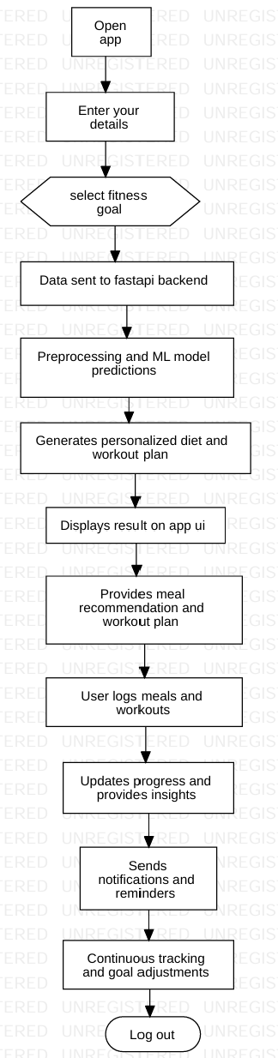
KIET Group of Institutions, Ghaziabad
Workflow Diagram
13

Slide 14










TECH STACK
KIET Group of Institutions, Ghaziabad
Flutter, Dart
(Frontend)
Numpy,Pandas
Scikit-Learn, Random Forest
(Machine Learning)
FastAPI, FIREBASE (BACKEND)
Uvicorn (FastAPI server) (Deployment)
4

Slide 15
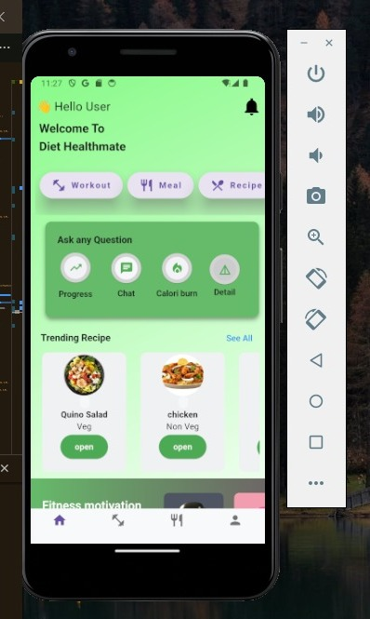
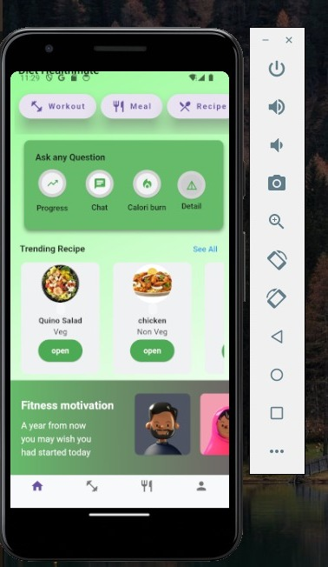
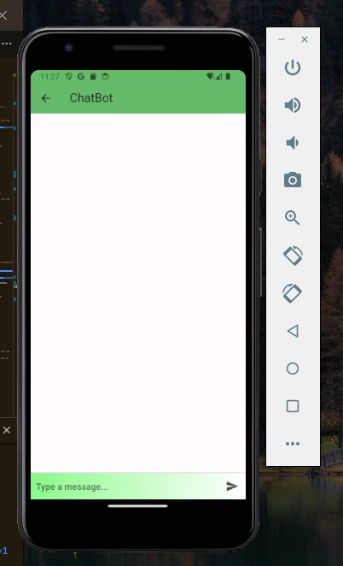
KIET Group of Institutions, Ghaziabad
Frontend Implementation
15

Slide 16
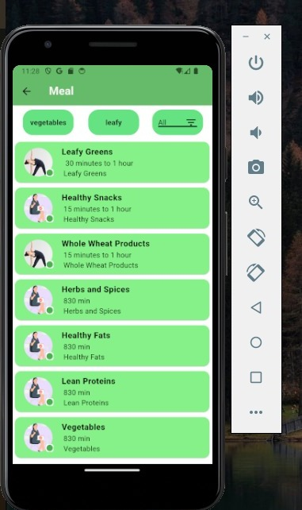
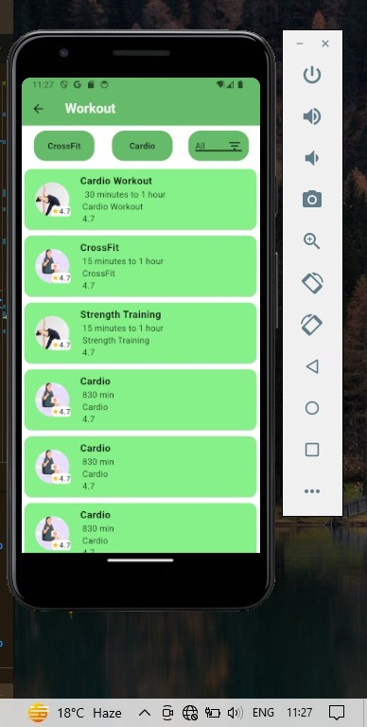
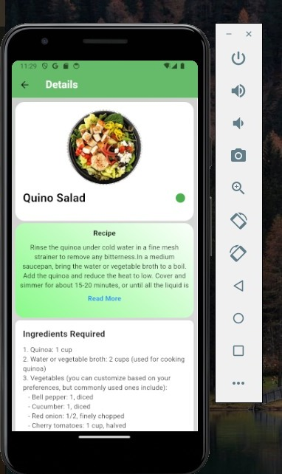
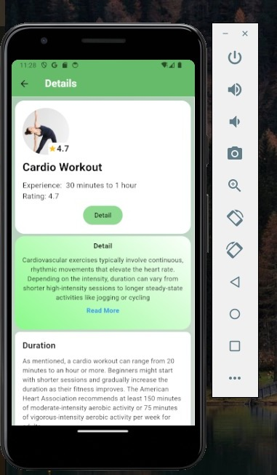
KIET Group of Institutions, Ghaziabad
Frontend Implementation
16

Slide 17
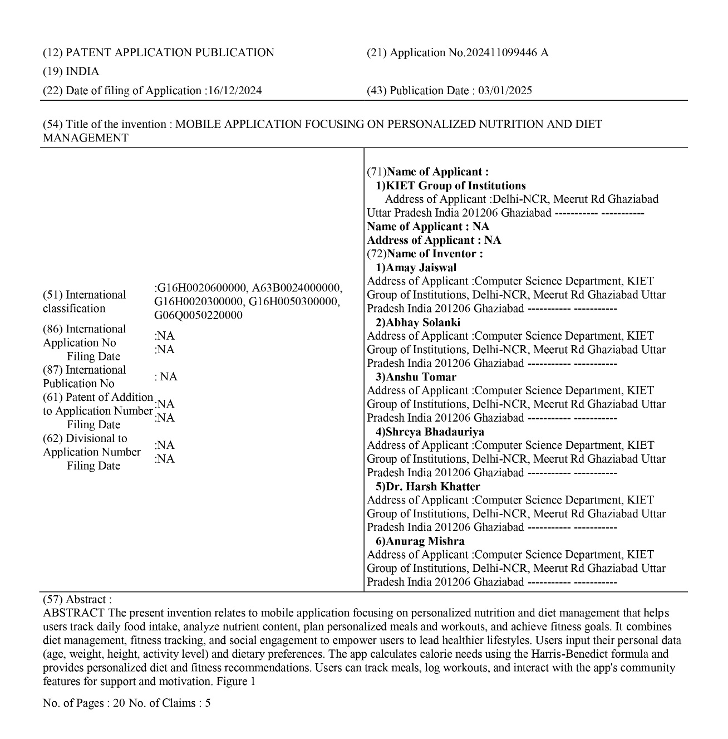
Patent Status – Published

Slide 18
KIET Group of Institutions, Ghaziabad
Conclusion With Result
In conclusion, our project is a success as it achieves its key objectives.
Users can easily track their daily food intake, get detailed insights into nutrition, and receive timely reminders for
consistency.
Setting and tracking fitness goals are made simple, and customized workout plans cater to individual needs.
The support and guidance feature, along with a diverse recipe database, enhances the user experience.
It provides valuable information on nutrition, workouts, and offers meal recommendations, making it easier
for users to adopt a healthier lifestyle.
Overall, our project bridges technology with personal well-being, empowering users to make informed
choices for a healthier and more balanced life.
As we continue refining and improving these features, we aim to have a lasting positive impact on
users' health and fitness journeys.
18

Slide 19
KIET Group of Institutions, Ghaziabad
REFERENCES
[1] https://www.researchgate.net/figure
[2] https://www.geeksforgeeks.org/
[3] Quora- https://www.ncbi.nlm.nih.gov
[4] https://nutritionalassessment.mumc.nl/en/nutritional-assessment
[5] FastAPI for Backend Development - GeeksforGeeks. Introduction to FastAPI Framework. https://www.geeksforgeeks.org
[6] Basal Metabolic Rate Calculation & Nutritional Guidelines - Mifflin, M.D., St Jeor, S.T. (1990). A new predictive equation for resting energy expenditure in healthy individuals. American Journal of Clinical Nutrition. https://pubmed.ncbi.nlm.nih.gov/2305711/
[7] Random Forest Algorithm for Predictions - Breiman, L. (2001). Random Forests. Machine Learning Journal. https://link.springer.com/article/10.1023/A:1010933404324
19

Slide 20
KIET Group of Institutions, Ghaziabad
Thank You

